Slide 1
Growing Incredible Managers:
Business Models for Innovation and building accountability
Prepared by
Greg Mathers, Certified Adizes Senior Associate
June-July 2019
Projekts Nr./ CFLA līgums Nr. 1.2.2.3/16/i/001

Slide 2
Building Accountability
To Bring Your Business
Model To Life

Slide 3
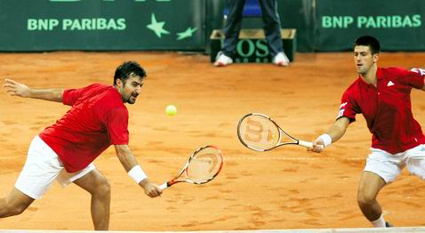
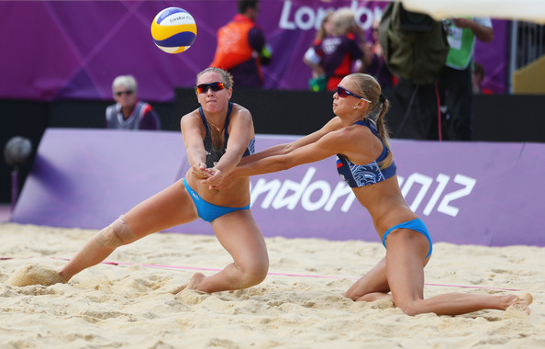
Responsibility
Accountability
Commitment
Engagement
…

Slide 4
I know what to do
I can do it
I will be rewarded

Slide 5
I know what to do
I can do it
I will be rewarded

Slide 6
I know what to do
I can do it
I will be rewarded

Slide 7
PERFORMANCE TRACKING SYSTEM
MISSION
STRUCTURE
REWARDS
ACCOUNTABILITY

Slide 8
PERFORMANCE TRACKING SYSTEM
MISSION
STRUCTURE
REWARDS
I know what to do
I can do it
I will be rewarded

Slide 9
Performance Tracking
Clarify tasks
Set performance levels
Match authority with task requirements

Slide 10
Performance Tracking
Clarify tasks
Set performance levels
Match authority with task requirements
Authority
What can I spend?
What do I control?
What can I influence?
Task

Slide 11

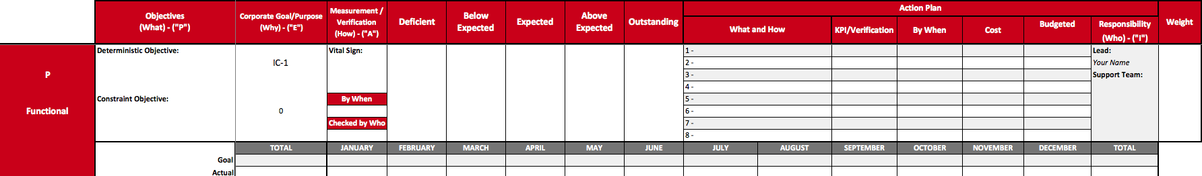
Goals and Objectives
Short term effective - objectives that provide value. Such objectives could be closing a pending contract, renewing a line of credit, surpassing a sales quota, etc.
Short term efficiency: objectives that increase efficiency in the short term. These objectives will include implementation of routines, processes and systems, such as a common expense reports, review of financial data on timely bases, performance evaluation of personnel, etc.

Slide 12
Types of Objectives
Long term effectiveness: Developmental objectives that focus on creating something new or a change. These objectives require creativity and risk taking. objectives will include product development, entering new markets, design of a new system or process, research, etc.
Long term efficiency: Objectives that will promote team building and alignment within the organization. Objectives in this category will include personnel development and training, staff outings, internal promotion of individuals, etc.

Slide 13
Goals & Objectives

Slide 14
A SIMPLE
EXAMPLE
Note that the accountability is superimposed on the color coded organizational chart

Slide 15
STEP 1
The green profit centers inform the plant of the quantity of products to manufacture (forecast).
The Plant (service center) estimates the costs and negotiates (with the green profit centers) a transfer price per unit based on the number of units.
Result
Computers: 5000 units @ $500/unit. Printers: 5000 units @ $300/unit.
Notes:
Changed - 7/19/01

Slide 16
A SIMPLE
EXAMPLE
Notes:
Changed - 7/19/01

Slide 17
STEP 2
The profit center determines the revenue from the sale of the products and the center’s operating costs.
Computers: 5000 units @ $1,000/unit.
Printers 5000 units @ $600/unit.
The Corporate Administration Excellence Center submits a proposed budget to support the profit center’s administrative needs.
Notes:
Changed - 7/19/01

Slide 18
A SIMPLE
EXAMPLE
Notes:
Changed - 7/19/01

Slide 19
STEP 3
The profit centers stretch the excellence center's budget and establish the level of support desired. The result is rolled up to the CEO.
The profit centers are stretched by the CEO with results rolled up to the CEO.
The CEO determines the administrative costs for the office of the CEO.
Notes:
Changed - 7/19/01

Slide 20
A SIMPLE
EXAMPLE
Notes:
Changed - 7/19/01

Slide 21
STEP 4
Once the profit centers have agreed on the budget and level of service of the excellence center they will determine how to share the costs of the excellence center, the flow from the plant and the cost of the CEO’s office.
This sharing process results in a “roughly right” net profitability measure for the profit centers
Notes:
Changed - 7/19/01

Slide 22
A SIMPLE
EXAMPLE
Notes:
Changed - 7/19/01

Slide 23
CEO & TRADITIONAL VIEW
Notes:
Changed - 7/19/01

Slide 24
USEAGE OF TERMS

Slide 25
CEO
Profit center
Inventory of FG
Inventory of M
Charged from
Inventory of Material
Charged to Inventory
of Finished goods
Not sold everything
Inflows:
Beginning inventory
0
Beginning inventory
0
Cont. from Computers
1300
Increase
Increase
Cont. from Printers
500
Increase of Computers
2500
Purchasing
2500
Increase of Printers
1500
Total
1800
Total
4000
Total
2500
Outflows:
Decrease
Decrease
Flow from Plant
0
Cogs to Computers
2200
Charge to Plant
2500
Cost from Adm.
900
Cogs to Printers
1300
CEO office
500
Total
1400
Total
3500
Total
2500
Contribution to
shareholders
400
Ending inventory
500
Ending inventory
0
Computers
Printers
Plant
Administration
Profit center
Profit center
Service center
Excellence center
Inflows:
Inflows:
Inflows:
Inflows:
Sales
4500
Sales
2600
Charges to Inventory
2500
Cogs
(2200)
Cogs
(1300)
Charges to Inventory
1500
Total
2300
Total
1300
Total
4000
Total
Outflows:
Outflows:
Outflows:
Outflows:
Charge from material
Cost of labor
Other cost
2500
Operative expenses
900
Operative expenses
1000
Operative expenses
800
1000
500
Total
1000
Total
800
Total
4000
Total
900
Contribution to CEO
1300
Contribution to CEO
500
Flow to CEO
0
Cost to CEO
(900)
Sharing 70%
980
Sharing 30%
420
320
80

Slide 26
MANAGING THE PORTFOLIO
Which is the “better” business?

Slide 27
MANAGING THE PORTFOLIO
Important points
Contribution is not the only measure of health
Only the internal and external profit centers “share” overhead expense
Sharing is not precise - “roughly right” is good enough
Notes:
Changed - 6/25/01

Slide 28
Managerial Accounting System
Inflows
DIRECTLY
ATTRIBUTABLE
Outflows
line
Contribution of the unit
Shared expenses
NOT DIRECTLY
ATTRIBUTABLE
Contribution to SH

Slide 29
Rewards
Tied to fulfilling objectives
and meeting financial targets
Profit sharing
Commissions
Bonuses
Individual rewards
Team rewards

Slide 30
Mission Action Plan or Statement of Strategic Intent
Based on client needs and environment analysis
CEO
Mgr
Mgr
Mgr
Tying the business model
All together
Goals & Objectives
Managerial Accounting System
Rewards

Slide 31
Thank You!
Greg Mathers, senior associate
Adizes Institute

